Slide 1


E-VARA
Privacy-First Executive Identity Intelligence
Understanding trust instead of just collecting data. Modern threat surface analysis, zero-trust monitoring, and institutional-grade protection built for the modern enterprise.
SPEAKER NOTES
Welcome, everyone. We are here today to present E-VARA. Today's standard enterprise security perimeter stops at the firewalls, yet the most critical vulnerabilities lie in plain sight: the digital identity footprint of our founders, executives, and leaders. E-VARA is designed from the ground up to solve this massive exposure blind spot without compromising fundamental user privacy.

Slide 2

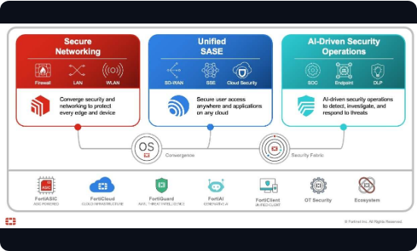
The Executive Threat Surface
Expanded Exposure Vectors: Modern attackers bypass corporate servers to target executives, founders, and public teams directly on personal networks.
Legacy Privacy Violations: Current legacy security solutions demand intrusive, raw private credentials to monitor exposure, breaking data trust.
Unusable Intelligence: Security teams receive chaotic data dumps rather than digestible, actionable, executive-grade intelligence reports.
SPEAKER NOTES
Let's look at the problem. Attackers are shifting from secure endpoints to personal vulnerabilities. However, current options fail. They either demand full administrative access to private profiles—violating trust—or they dump raw data without analysis. Securing leaders shouldn't require violating their digital sovereignty. E-VARA changes this dynamic entirely.

Slide 3
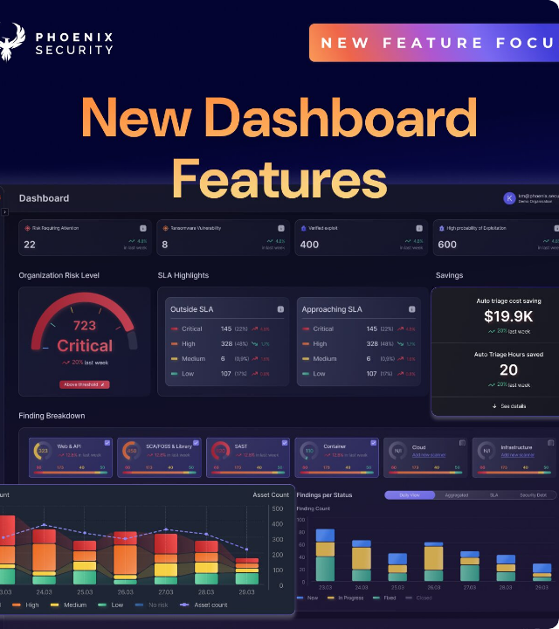
The Executive Defense Layer
Absolute Raw Data Privacy: E-VARA never ingests or stores raw identifiers, guaranteeing absolute privacy.
Explainable Threat Metrics: Risk scoring translates threat telemetry into transparent, actionable intelligence.
Institutional-Grade Dossiers: Compile beautiful, ready-to-share PDF briefings for operations and insurance.
SPEAKER NOTES
E-VARA introduces the ultimate Executive Defense Layer. It runs silently, verifying exposure vectors with explainable intelligence scores rather than vague, automated alerts. Crucially, operations can immediately compile polished dossiers to briefs decision-makers in real-time, matching executive-level standards.

Slide 4








Zero-Trust Solution Architecture
Client-Side Hashing
Edge Worker Cloud
Active Aggregators
Ingestion pipeline utilizes local SHA-256 client hashing. Zero raw text or critical credentials ever travel through external servers or third-party networks.
Highly scalable, asynchronous edge environment engineered via React, TypeScript, and Supabase database handlers for real-time risk orchestration.
Instant secure API queries securely sync live external threat intel repositories—including HaveIBeenPwned API—without identity exposure.
SPEAKER NOTES
Our technical foundation is rock solid. We build on an asynchronous, edge-computed architecture utilizing client-side SHA-256 hashing. This means identity verification is processed locally before any cloud transactions take place. This lightweight, serverless framework guarantees enterprise scaling and absolute zero-knowledge security.

Slide 5

Commercial Model & Monetization
Target Markets
Monetization Streams
→
Family Offices & VIPs: High-net-worth teams requiring private, hyper-customized corporate shields.
→
B2B / B2B2C SaaS: Highly predictable recurring subscriptions categorized by seat tiers.
→
Executive Protection: Enhancing physical protective details with proactive digital counter-intelligence suites.
→
Enterprise Licensing: Managed institutional security plans containing active white-label styling controls.
→
Cyber Insurers: Underwriting risk reduction metrics via validated real-time team threat indexing.
→
Threat API Access: Premium programmatic developer channels linking E-VARA databases into live SOC workflows.
SPEAKER NOTES
E-VARA's business model is built for fast expansion. We target high-margin buyers: elite security services, private wealth family offices, and cyber insurance providers who want to reduce claims payouts. We monetize on three layers: recurring subscription tiers, custom white-labeled enterprise structures, and API integration tools.

Slide 6
Product Scaling & Roadmap
Q2 - Enterprise Push
Q4 - Global Shield
Onboard top physical executive security networks to scale premium high-net-worth customer acquisition.
Deploy multi-channel instant threat mitigation channels and secure group workspace environments.
Q1 - Core Polish
Q3 - Deep Intel
Upgrade client-side secure cryptographic hashing modules and dashboard interface latency.
Construct customized proprietary zero-knowledge dark-web APIs and zero-exposure search scrapers.
SPEAKER NOTES
Our upcoming development plan is organized into four logical segments. We begin with client-side cryptographic engine scaling, immediately transition to enterprise co-selling and channel partnerships in Q2, proceed to deeper advanced threat scraping integrations in Q3, and culminate with collaborative corporate risk environments in Q4.

Slide 7


The Force Behind E-VARA
Scaling Cybersecurity Talents
Guided by cyber intelligence veterans and software engineering pioneers. We are entering our next phase of rapid security deployment and are expanding our core structure across engineering, partnerships, and operations.
Lead Cryptographic Engineer: Standardizing secure multi-party calculations & hashing.
Director of Enterprise Accounts: Capturing institutional cyber channels & family offices.
Threat Intelligence Analyst: Designing proprietary correlation structures & database APIs.
SPEAKER NOTES
To deliver on our goals, we are actively recruiting world-class engineering, sales, and analytics talent. We are looking for a Cryptographic Engineer to secure our zero-knowledge engine, an Enterprise Accounts Director to manage family office opportunities, and a Threat Analyst to expand our telemetry. We welcome your support and partnership. Thank you.

